Slide 1
Autodesk BIM solutions & Geotechnical data
Geotechnical Data Standardization Workshop
Paris, January 22-24
Vincent Fredon
Technical Sales Specialist | Blog Civil Made in France http://civilfrance.typepad.com

Slide 2

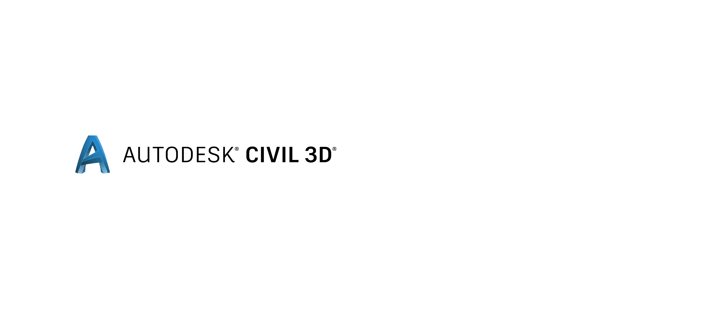

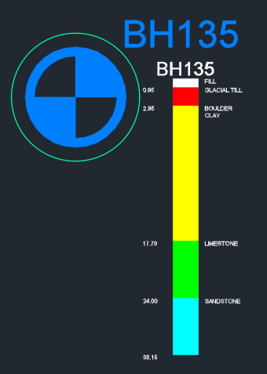
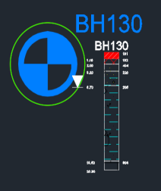
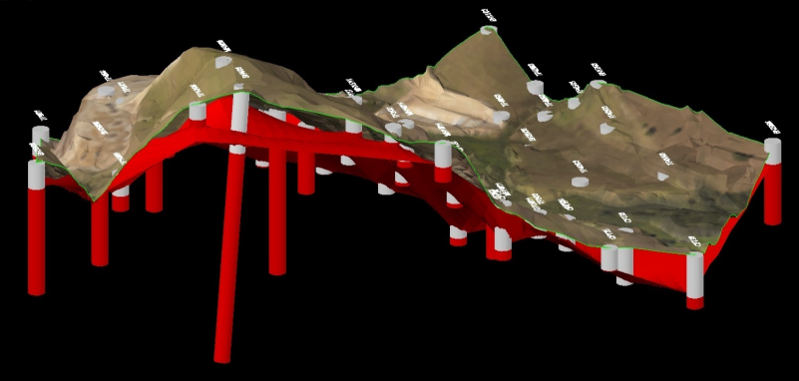
Autodesk solutions for Geology
Geological data modelization for infrastructure design
Includes Autodesk Geotechnical
Module
BIM Infrastructure Detailed Design
Surfaces creation & edition
Terrain & subsurfaces
Earthworks optimization
Geotechnical data managment for Civil 3D
Boreholes modelization
Easy creation of geology strata Civil 3D surfaces
Borehole
Surface
Fence diagram

Slide 3
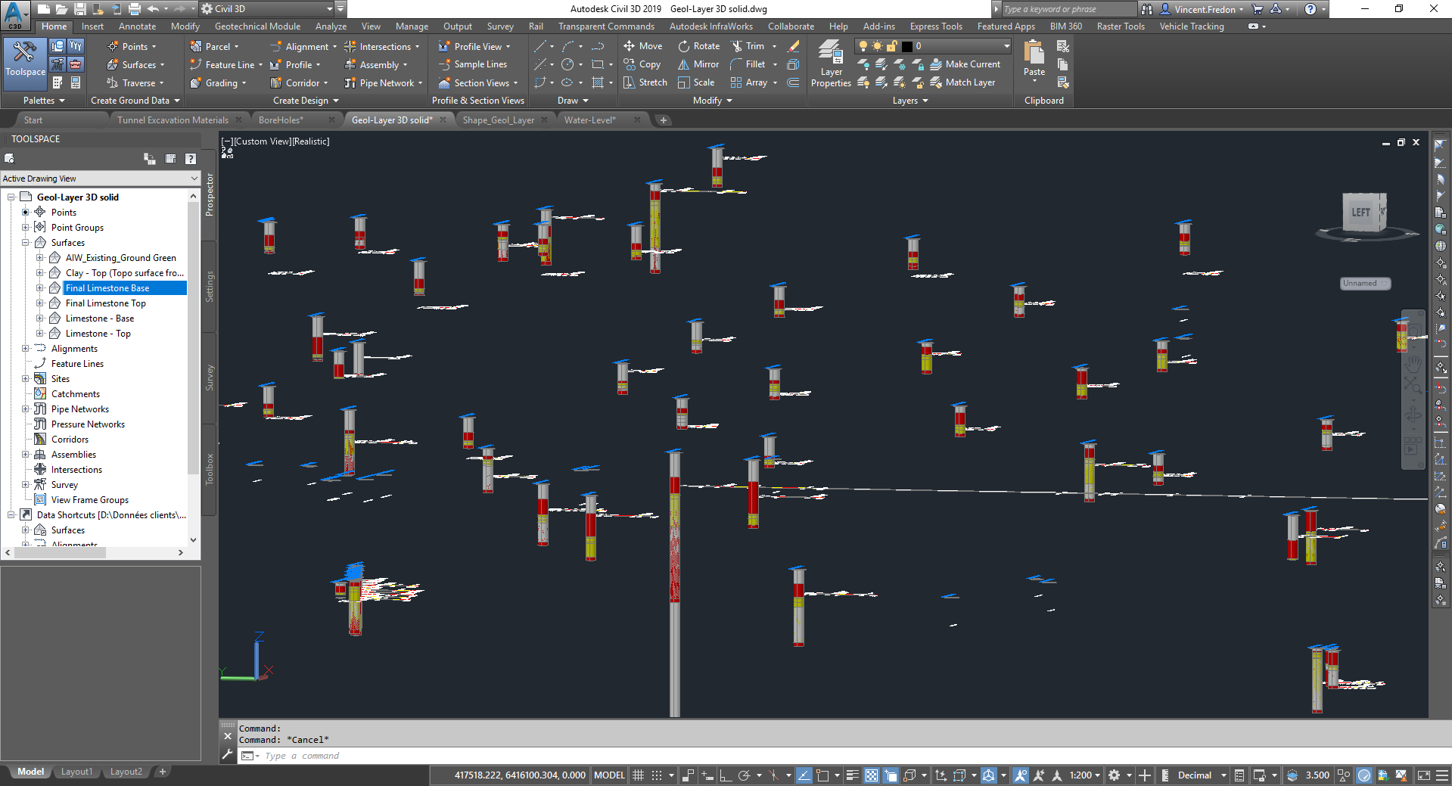
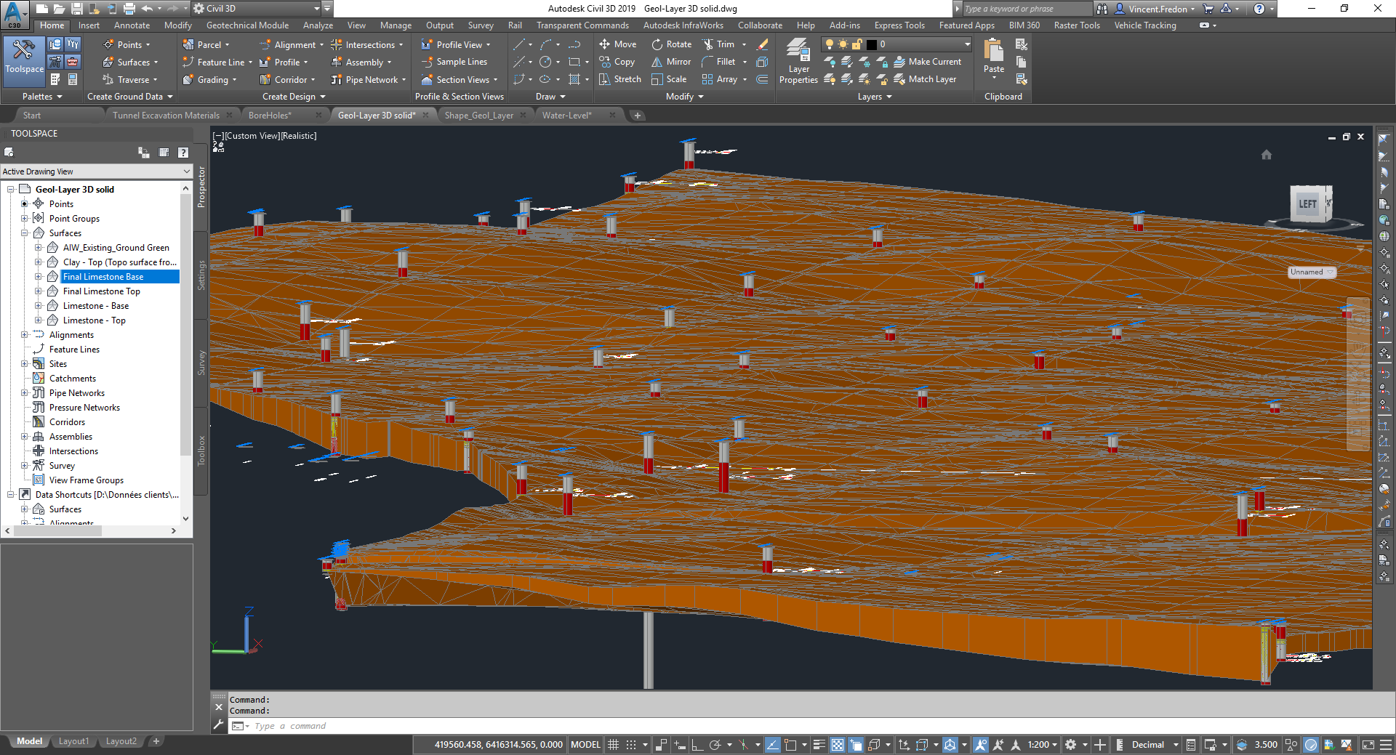
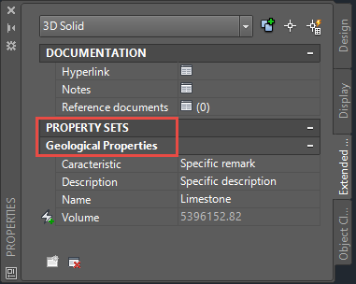
Autodesk solutions for Geology
Geological 3D objects with information
Boreholes
Surfaces
Layers + information
(DWG & IFC)

Slide 4
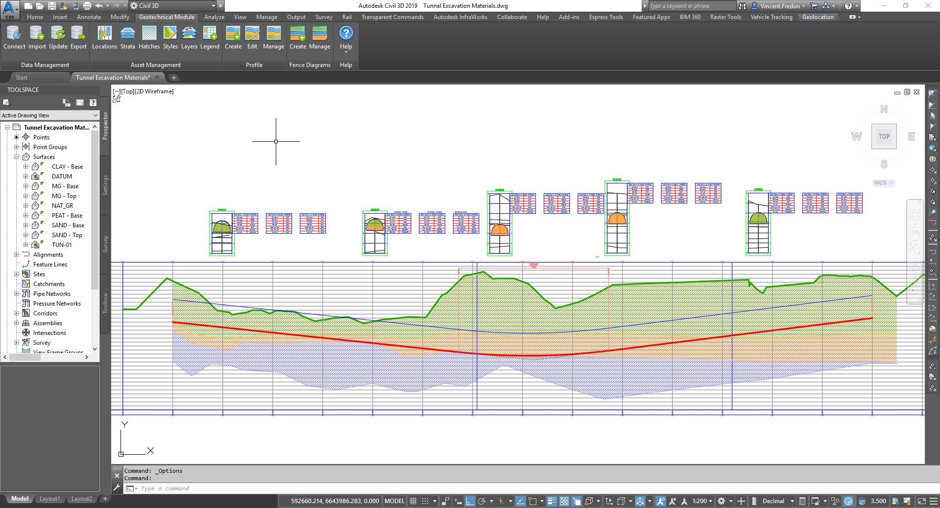
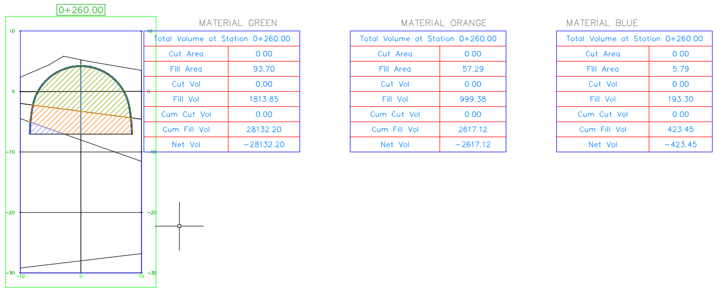
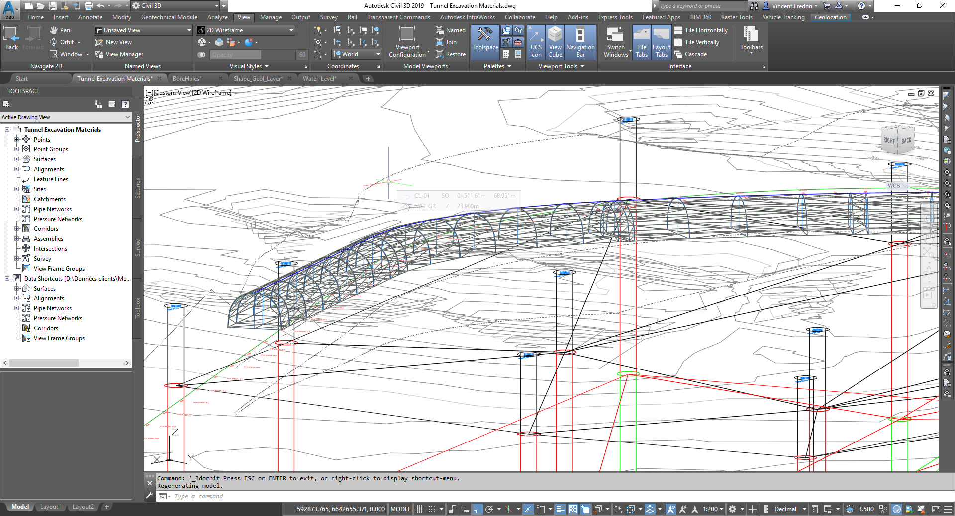
Autodesk solutions for Geology
Added value of geological objects : earthworks optimization
Dynamic modelization and earthworks quantification for optimization

Slide 5
Autodesk solutions for Geology
Advanced geological layer edition : manual edition for more accuracy

Slide 6

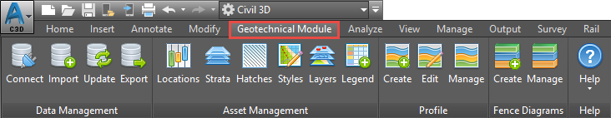
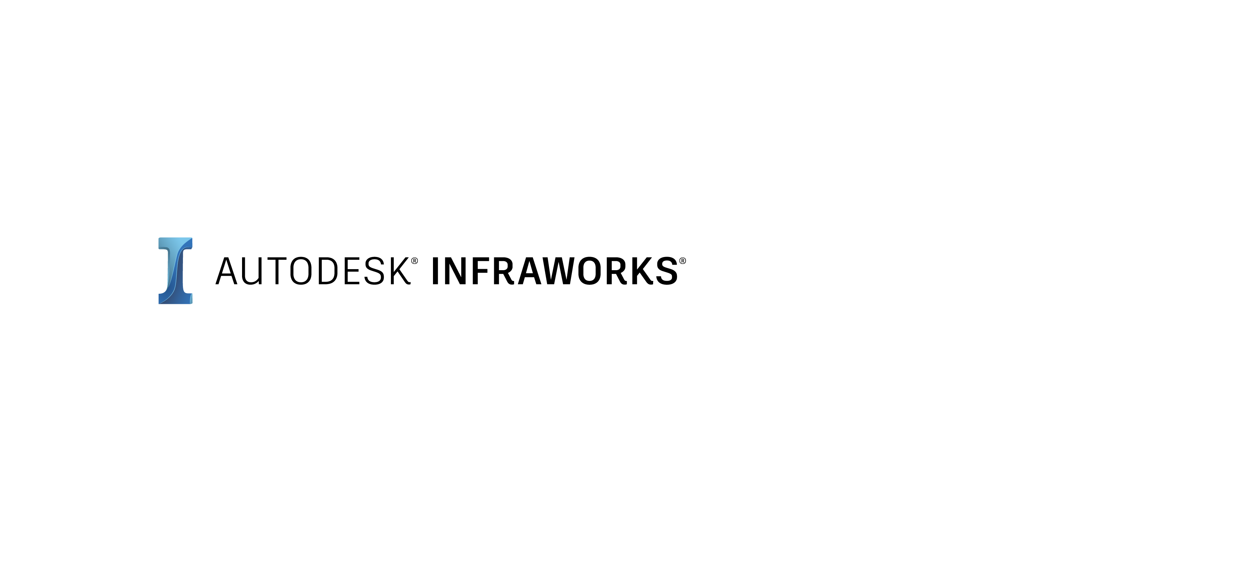


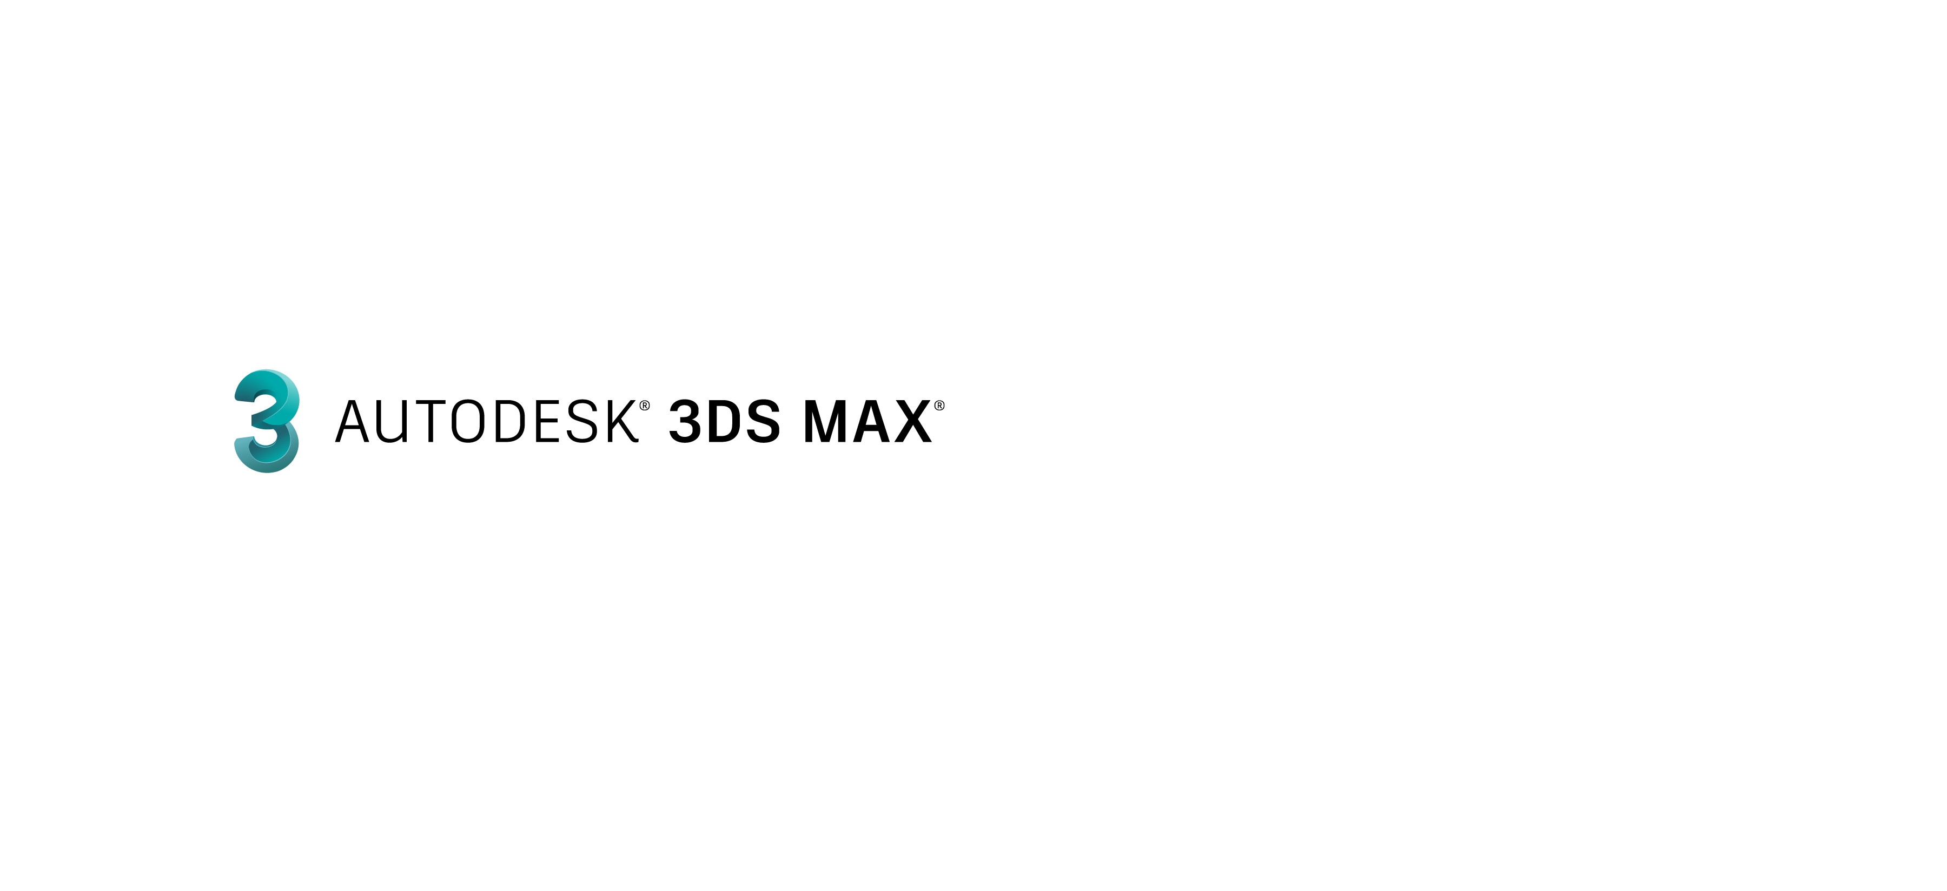

Autodesk solutions for Geology
Geological data use in Autodesk solutions
Geological objects modelization
Infrastructure BIM Platform
Preliminary design tools
Aggregation – Visualization - Communication
Platform for Collaboration

Slide 7
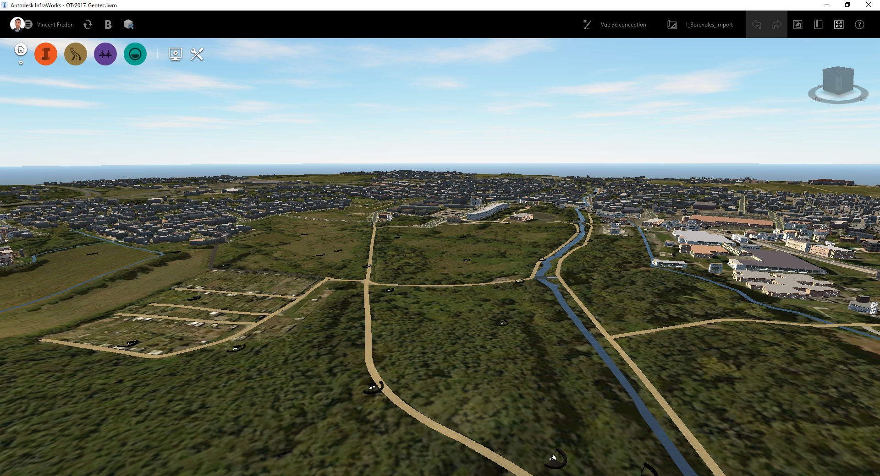
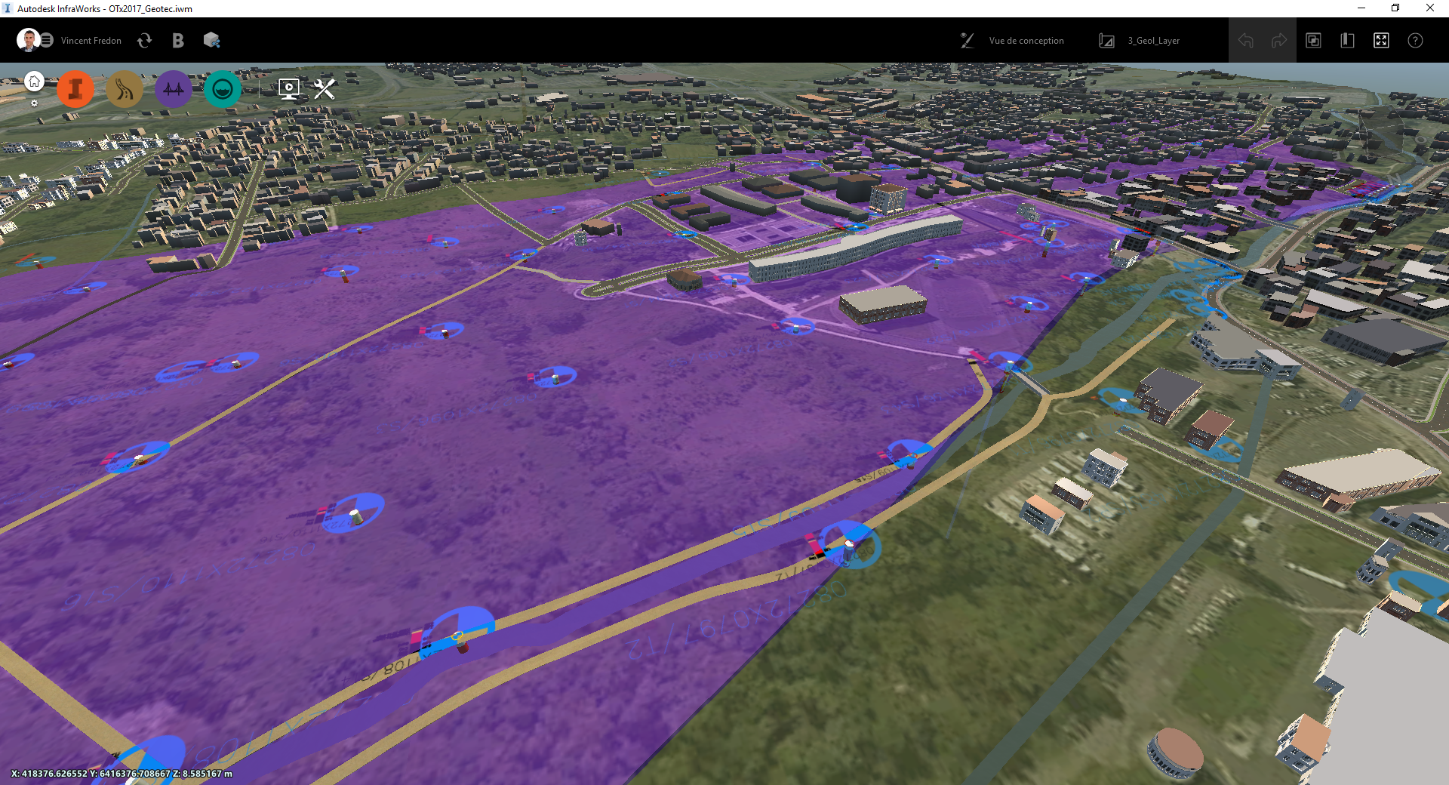
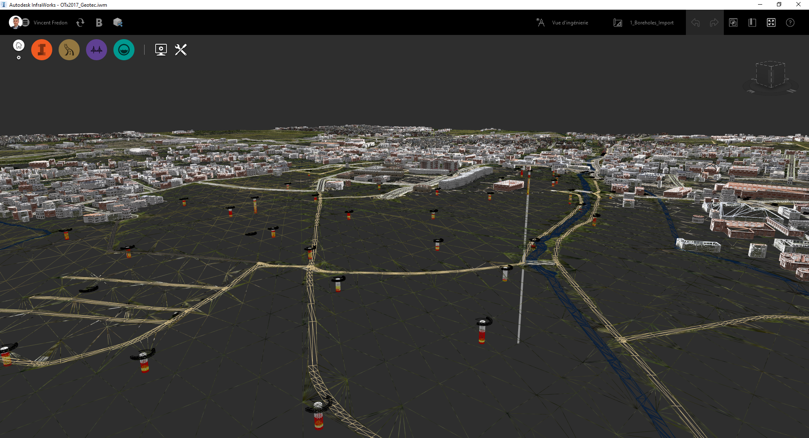
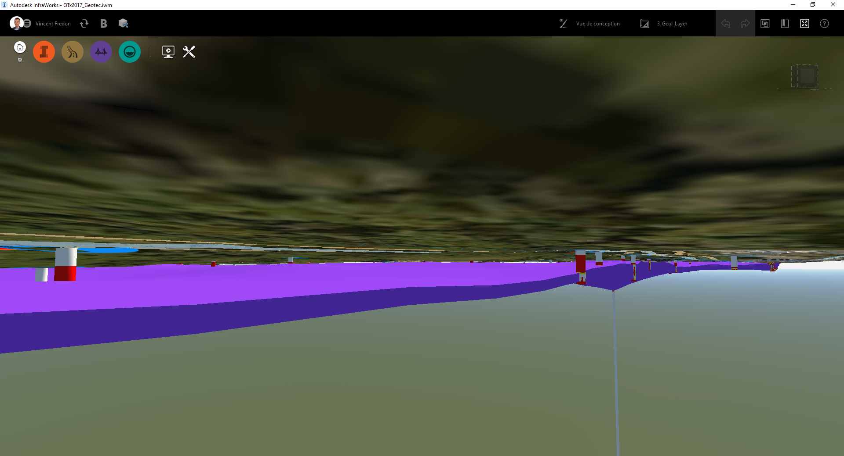
Autodesk solutions for Geology
Geological objects in InfraWorks for better context and better decision

Slide 8
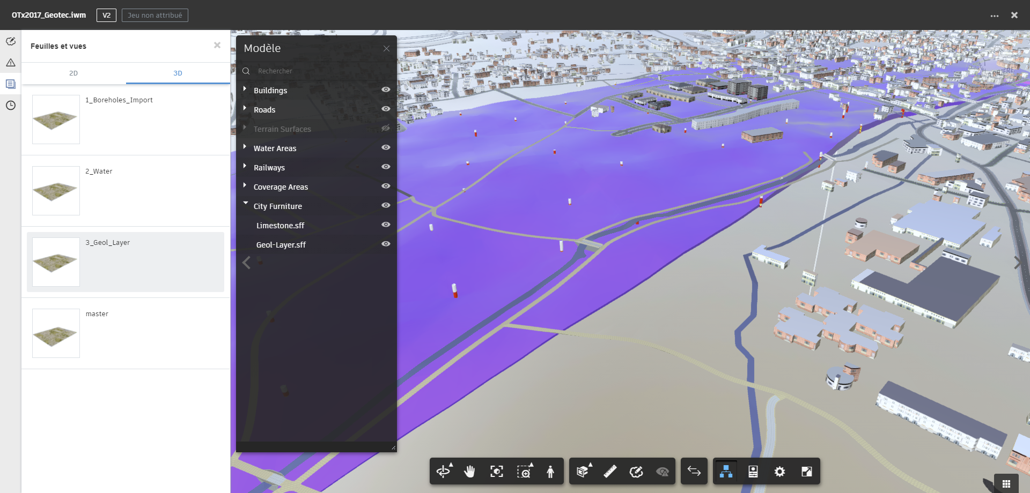
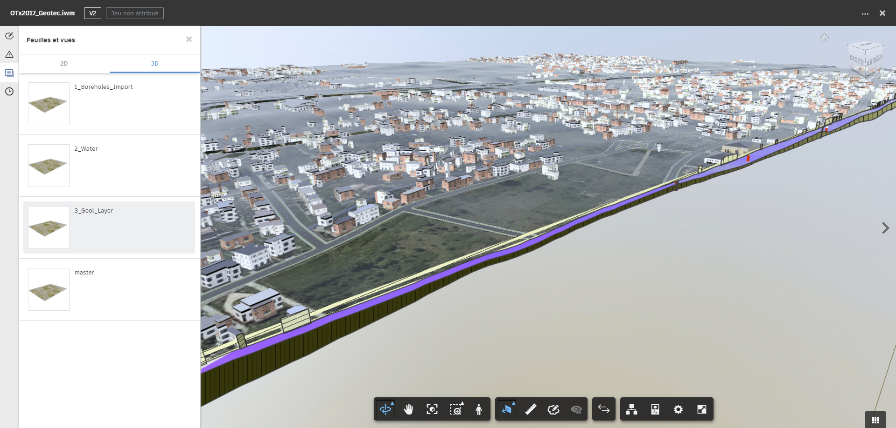
Autodesk solutions for Geology
Models with geological objects in collaborative plateform for BIM workflows

